Slide 1
Discurso acadêmico
Written Communication
13 de Novembro de 2017

Slide 2
Estratégias de parafrasear
1. Changing word order
There are also major concerns about how the detention system affects the mental and physical health of the detainees. | Secondly, the mental or physical effects of detained asylum seekers are not taken seriously by the government.

Slide 3
Estratégias de parafrasear
2. Using diferent conjunctions
Furthermore, mandatory detention does not act as a deterrent. | Moreover, the survey shows that there are approximately 600 asylum seekers waiting in Indonesia to take a boat to Australia.

Slide 4
Estratégias de parafrasear
3. Using synonyms
… when people are already traumatised by past persecution and do not know what the future holds for them … | … when people are not sure about their future …

Slide 5
Estratégias de parafrasear
4. Alternating between active and passive
There are also major concerns about how the detention system affects the mental and physical health of the detainees. | Secondly, the mental or physical effects of detained asylum seekers are not taken seriously by the government.

Slide 6
Estratégias de parafrasear
5. Taking information out of the nominal group
… and it is the only country world-wide with a national, mandatory detention policy which cannot be reviewed by a court. | Furthermore, Australian detention policy does not have the system to allow a court to review the policy.

Slide 7
Estratégias de resumir
1. Putting information into a nominal group
Ten years since the introduction of mandatory detention for asylum-seekers lacking visas, Amnesty International is appealing to the Australian government to step back and consider the costs and consequences of the policy and to bring it in line with international human rights standards. | International criticism should not be taken …

Slide 8
Estratégias de resumir
2. Changing word class
… major concerns about how the detention system affects the mental and physical health of the detainees. | Australia’s default of international obligations under international treaties and lack of careful consideration of the physical or mental health effects on detained asylum seekers have been recognised.

Slide 9
Estratégias de resumir
3. Synthesising information from diferent sources
 | Asylum seekers mainly from Asia, Iraq and Afghanistan have been automatically detained to the detention centres according to the Migration Act.

Slide 10
Técnicas de citar
Quotes quotation marks
Southern Europeans – Spanish and Portuguese – writing in the social sciences have in particular come under attack for language related issues. They have been accused of “severe wordiness” (Barbin, 2008: 379), writing “arguments [that] are vague and confusing” (Dueñas, 2012: 148), writing in a style that is “a little bit over the top and too pretentious” and “too Latin for a North-West European” (Lillis & Curry, 2010: 150), and using “weasel words (‘phenomena’, ‘approach’, ‘consideration’) [in a way that] is useless to the reader” (Lillis & Curry, 2010: 150).
Author publication date page number

Slide 11
Técnicas de citar
Informação parafraseada ou resumida
Bennet (2012) offers a potential explanation for such criticism.
author’s name (date) as subject of clause before paraphrased/summarized idea

Slide 12
Técnicas de citar
Informação parafraseada ou resumida
It has been noted that the United States of America is dominant in setting standards for the field of economics (Coupé, 2003; Frey & Eichenberger, 1997; Diamond, 1989).
(author’s name, date) after paraphrased/summarized idea

Slide 13
Técnicas de apresentar informação parafraseada ou resumida
Subject | Typical verbs
the work itself e.g. The study, The paper, Research | show, highlights, examines, confirms, suggests, analyses, looks at, illustrates, explains, … | Several studies note that the United States of America is dominant in setting standards for the field of economics (Coupé, 2003; Frey & Eichenberger, 1997; Diamond, 1989).

Slide 14
Técnicas de apresentar informação parafraseada ou resumida
Subject | Typical verbs | Example
the author’s name | shows, highlights, examines, claims, notes, corroborates, illustrates, indicates, argues, suggests, proves, implies, finds, demonstrates, posits … | Coupé (2003), Frey and Eichenberger (1997) and Diamond (1989) note that the United States of America is dominant in setting standards for the field of economics.

Slide 15
Respostas escritas nos testes e nos exames
a command or instruction | Use an increase in the demand to illustrate and explain the roles/functions played by the price of a good in a market system. (8 points)
a non-finite clause of purpose | Use an increase in the demand to illustrate and explain the roles/functions played by the price of a good in a market system. (8 points)
a direct question | What economic system does it represent, how does it work, and how important is the system to the economy? (250-300 words)
a statement that supplies information
a chart or graph
a combination of the above | Consider the information in Figure 1. What economic system does it represent, how does it work, and how important is the system to the economy? (250-300 words)

Slide 16
In the question it is important to identify
the concept being tested,
the question word (if present),
what the verbs are asking you to do, and
any reference nouns (if present).
This information helps you to define the way you develop information in the paragraph, and therefore what language is appropriate.

Slide 17
A definition of a concept,
A descriptive report on taxonomic relations, component parts or features of a concept,
A causal explanation of why things happen,
A sequential explanation of how things work/ how they came about (describing change over time),
An example,
An analytical response (conclusions based on description and analysis of data),
An analytical exposition (arguing a point of view on a topic),
An analytical discussion (presenting & evaluating different points of view on a topic), or
A mixture of the above.

Slide 18
Respostas escritas nos testes e nos exames
Use an increase in the demand to illustrate and explain the roles/functions played by the price of a good in a market system.
command
clause of purpose
technical concepts

Slide 19
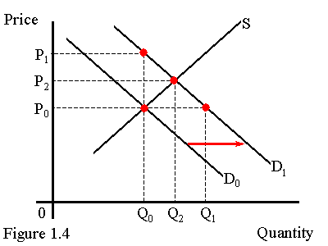
The price of an item
1. informs,
2. rations, and
3. motivates.
Consider the market for apartments and begin with an initial equilibrium at (P₀,Q₀) as illustrated in the graph provided.
An increase in demand is a rightward movement of the demand curve as shown from D₀ to D₁.
The immediate effect of this change is an increase in the price to P₁ (since the quantity of housing supplied increases slowly). This new higher price informs both buyers and sellers that apartments are relatively more scarce.
The higher price also rations the available housing -- apartments go to those who are willing and able to pay the higher rental rate.
The higher price also motivates buyers and sellers to adapt to the changed market conditions. The higher price means that the opportunity cost of housing has risen and prospective tenants have an incentive to economize on housing by living at home, taking in room-mates, etc. The higher price also makes the real estate rental market more profitable. The prospect of higher profits motivates sellers to offer more rental housing.
These responses lead to the new equilibrium at (P₂,Q₂)

Slide 20
The price of an item TECHNICAL
1. informs, CONCEPT
2. rations, and
3. motivates.
Consider the market for apartments and begin with an initial equilibrium at (P₀,Q₀) as illustrated in the graph provided.
FUNCTIONS
An increase in demand is a rightward movement of the demand curve as shown from D₀ to D₁.
The immediate effect of this change is an increase in the price to P₁ (since the quantity of housing supplied increases slowly). This new higher price informs both buyers and sellers that apartments are relatively more scarce.
The higher price also rations the available housing -- apartments go to those who are willing and able to pay the higher rental rate.
The higher price also motivates buyers and sellers to adapt to the changed market conditions. The higher price means that the opportunity cost of housing has risen and prospective tenants have an incentive to economize on housing by living at home, taking in room-mates, etc. The higher price also makes the real estate rental market more profitable. The prospect of higher profits motivates sellers to offer more rental housing.
These responses lead to the new equilibrium at (P₂,Q₂)

Slide 21
The price of an item
1. informs,
2. rations, and
3. motivates.
Consider the market for apartments and begin with an initial equilibrium at (P₀,Q₀) as illustrated in the graph provided.
EXAMPLE (illustrate … the roles & functions)
An increase in demand is a rightward movement of the demand curve as shown from D₀ to D₁.
The immediate effect of this change is an increase in the price to P₁ (since the quantity of housing supplied increases slowly). This new higher price informs both buyers and sellers that apartments are relatively more scarce.
The higher price also rations the available housing -- apartments go to those who are willing and able to pay the higher rental rate.
The higher price also motivates buyers and sellers to adapt to the changed market conditions. The higher price means that the opportunity cost of housing has risen and prospective tenants have an incentive to economize on housing by living at home, taking in room-mates, etc. The higher price also makes the real estate rental market more profitable. The prospect of higher profits motivates sellers to offer more rental housing.
These responses lead to the new equilibrium at (P₂,Q₂)

Slide 22
The price of an item
1. informs,
2. rations, and
3. motivates.
Consider the market for apartments and begin with an initial equilibrium at (P₀,Q₀) as illustrated in the graph provided.
An increase in demand is a rightward movement of the demand curve as shown from D₀ to D₁.
The immediate effect of this change is an increase in the price to P₁ (since the quantity of housing supplied increases slowly). This new higher price informs both buyers and sellers that apartments are relatively more scarce.
The higher price also rations the available housing -- apartments go to those who are willing and able to pay the higher rental rate.
The higher price also motivates buyers and sellers to adapt to the changed market conditions. The higher price means that the opportunity cost of housing has risen and prospective tenants have an incentive to economize on housing by living at home, taking in room-mates, etc. The higher price also makes the real estate rental market more profitable. The prospect of higher profits motivates sellers to offer more rental housing.
These responses lead to the new equilibrium at (P₂,Q₂)
SEQUENTIAL EXPLANATION (CHANGE OVER TIME) (explain the role & functions …)

Slide 23
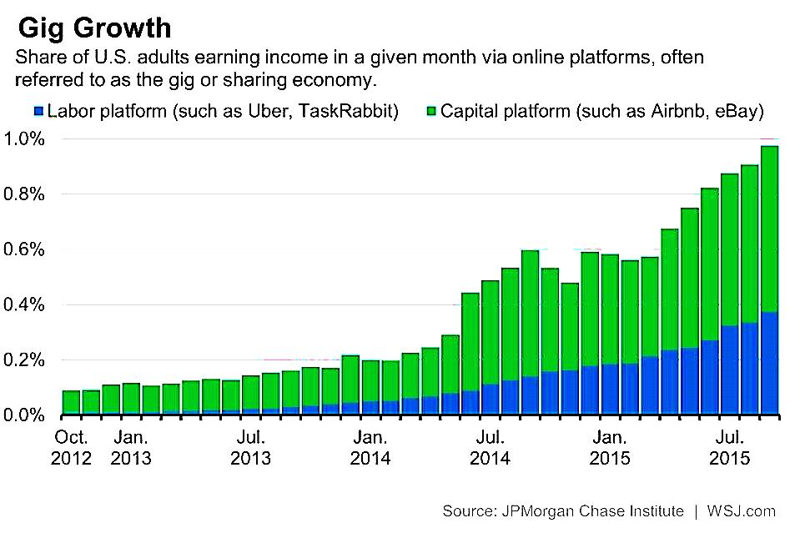
Consider the information in Figure 1. What economic system does it represent, how does it work, and how important is the system to the economy?
Direct questions
Command
Technical concept
Visual element

Slide 24
The figure shows information about the gig economy. The gig economy is also known as the sharing economy or collaborative consumption. It can be defined as an economic system that uses old-fashioned mechanisms such as bartering, swapping, trading, renting, or lending but in a way that has been reinvented through the use of modern technology. It contrasts with the hyper-consumption of the 20th century, where ownership was valued, and instead values use of a product or experience over ownership. While Rachel Botsman argues that there are three systems by which collaborative consumption works: product service systems; collaborative lifestyles; and redistribution markets, the graph reinterprets them as two: labor platforms and capital platforms. The difference stems from a difference in perspective. The classification into three systems suggests a user’s point of view whereas the classification into two systems is based on the provider’s point of view.
In labor platforms people compete to offer a service, which is coordinated through a digital online platform, and for which they operate as independent contractors. For example, an Uber driver provides a transport service similar to that of a taxi-driver, but is not affiliated with a taxi company. Task-Rabbit centralises people who compete to provide a variety of services such as buying groceries for someone, walking their dog, or cleaning their house.
In capital platforms unused assets are rented out or sold. For example, a house-owner might choose to rent out spare room through Airbnb, or even the parking space in front of the house. Someone who owns a drill could rent it out to someone who needs to use one. Unused assets can be sold through websites such as e-bay or OLX. This market can be global, and relies on the internet to enable buyers and sellers to meet.
The gig economy has been growing, as the graph shows. The share of people earning money from capital platforms, i.e. from selling or renting out their unused assets, increased about six-fold between October 2012 and July 2015 while those who earned money by providing a labour service grew around fifteen-fold between July 2013 and July 2015. Although the share of U.S. adults earning income through the sharing economy still currently represents less than 1%, the steady growth trends in both the labour platforms and the capital platforms look set to continue.

Slide 25
The figure shows information about the gig economy. The gig economy is also known as the sharing economy or collaborative consumption. It can be defined as an economic system that uses old-fashioned mechanisms such as bartering, swapping, trading, renting, or lending but in a way that has been reinvented through the use of modern technology. It contrasts with the hyper-consumption of the 20th century, where ownership was valued, and instead values use of a product or experience over ownership. While Rachel Botsman argues that there are three systems by which collaborative consumption works: product service systems; collaborative lifestyles; and redistribution markets, the graph reinterprets them as two: labor platforms and capital platforms. The difference stems from a difference in perspective. The classification into three systems suggests a user’s point of view whereas the classification into two systems is based on the provider’s point of view.
TECHNICAL CONCEPT (what economic system does it represent?)
DEFINITION OF CONCEPT
In capital platforms unused assets are rented out or sold. For example, a house-owner might choose to rent out spare room through Airbnb, or even the parking space in front of the house. Someone who owns a drill could rent it out to someone who needs to use one. Unused assets can be sold through websites such as e-bay or OLX. This market can be global, and relies on the internet to enable buyers and sellers to meet.
The gig economy has been growing, as the graph shows. The share of people earning money from capital platforms, i.e. from selling or renting out their unused assets, increased about six-fold between October 2012 and July 2015 while those who earned money by providing a labour service grew around fifteen-fold between July 2013 and July 2015. Although the share of U.S. adults earning income through the sharing economy still currently represents less than 1%, the steady growth trends in both the labour platforms and the capital platforms look set to continue.

Slide 26
The figure shows information about the gig economy. The gig economy is also known as the sharing economy or collaborative consumption. It can be defined as an economic system that uses old-fashioned mechanisms such as bartering, swapping, trading, renting, or lending but in a way that has been reinvented through the use of modern technology. It contrasts with the hyper-consumption of the 20th century, where ownership was valued, and instead values use of a product or experience over ownership. While Rachel Botsman argues that there are three systems by which collaborative consumption works: product service systems; collaborative lifestyles; and redistribution markets, the graph reinterprets them as two: labor platforms and capital platforms. The difference stems from a difference in perspective. The classification into three systems suggests a user’s point of view whereas the classification into two systems is based on the provider’s point of view.
In labor platforms people compete to offer a service, which is coordinated through a digital online platform, and for which they operate as independent contractors. For example, an Uber driver provides a transport service similar to that of a taxi-driver, but is not affiliated with a taxi company. Task-Rabbit centralises people who compete to provide a variety of services such as buying groceries for someone, walking their dog, or cleaning their house.
In capital platforms unused assets are rented out or sold. For example, a house-owner might choose to rent out spare room through Airbnb, or even the parking space in front of the house. Someone who owns a drill could rent it out to someone who needs to use one. Unused assets can be sold through websites such as e-bay or OLX. This market can be global, and relies on the internet to enable buyers and sellers to meet.
DESCRIPTIVE REPORT ON COMPONENT PARTS & FEATURES (How does it work?)

Slide 27
The figure shows information about the gig economy. The gig economy is also known as the sharing economy or collaborative consumption. It can be defined as an economic system that uses old-fashioned mechanisms such as bartering, swapping, trading, renting, or lending but in a way that has been reinvented through the use of modern technology. It contrasts with the hyper-consumption of the 20th century, where ownership was valued, and instead values use of a product or experience over ownership. While Rachel Botsman argues that there are three systems by which collaborative consumption works: product service systems; collaborative lifestyles; and redistribution markets, the graph reinterprets them as two: labor platforms and capital platforms. The difference stems from a difference in perspective. The classification into three systems suggests a user’s point of view whereas the classification into two systems is based on the provider’s point of view.
In labor platforms people compete to offer a service, which is coordinated through a digital online platform, and for which they operate as independent contractors. For example, an Uber driver provides a transport service similar to that of a taxi-driver, but is not affiliated with a taxi company. Task-Rabbit centralises people who compete to provide a variety of services such as buying groceries for someone, walking their dog, or cleaning their house.
DATA DESCRIPTION & ANALYSIS (How important is it in the economy?)
The gig economy has been growing, as the graph shows. The share of people earning money from capital platforms, i.e. from selling or renting out their unused assets, increased about six-fold between October 2012 and July 2015 while those who earned money by providing a labour service grew around fifteen-fold between July 2013 and July 2015. Although the share of U.S. adults earning income through the sharing economy still currently represents less than 1%, the steady growth trends in both the labour platforms and the capital platforms look set to continue.

